Slide 1
BPM: The Processes Are The Business
Robin Bloor
CEO, Bloor Research

Slide 2
Segments
eBusiness: Business As Usual
Business Process Archipelago
The Need For Business Process Management

Slide 3
eBusiness:
Business As Usual

Slide 4
The Competitive Dynamic
Innovation
& Invention
Business
Process
Change
Improved
Capability

Slide 5
The Influence of IT on Management
Information Technology | Management Style | Speed of Change
Batch Computers | Centralised, Hierarchical | Slow
Online Computers | Divisional, Delegated | Moderate
PCs and PC LANs | Federal, Downsized | Fast
Internet | Delegated, Virtual | Very Fast

Slide 6
IT Disruption: Metcalfe’s Law
The (potential) value of a network is proportional to the square of the number of nodes (users)

Slide 7
Metcalfe’s Law
2001 – 2002
  About 175 million new users (up to 502m)
  eCommerce grew by 68% to $600b (IDC)
If Metcalfe’s Law holds true then the potential value of the Internet increased by 235% in one year (2000/2001 was similar)
eCommerce expected to grow by 66% this year to $1trillion (IDC)

Slide 8
The Speed of the Web
Supply Chain
Company
Company
Customer
Internal
Systems
Internal
Systems
Supply Chain Mgt
(B2B)
eCRM
(B2C)

Slide 9
The One-to-Many Transactions
Publish/Subscribe: One party publishes, the other subscribes
The PS Mechanisms:
  email
  Web Sites
  MUDs (electronic communities)
  Search Engines
The introduction of ‘one-to-many’
changes the customer relationship

Slide 10
The Buy/Sell Spectrum
The Negotiated Deal
The Brokered Deal
The Fixed Price Sale
The Auction
The Pure Market

Slide 11
The Trading Model
Sellers
Buyers
Trusted
Third
Party
Market
Maker

Slide 12
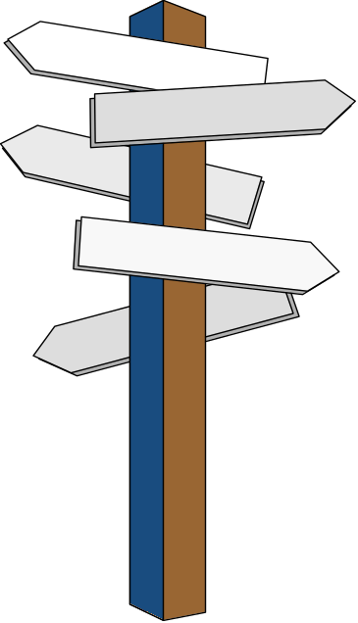
Changing Business Transactions
Buy/sell
Invoice, Order, Payment
Customer Inquiries
Customer Service
Channels: in person, web site, telephone, mobile, digital TV

Slide 13
Michael Porter’s Value Chain
Firm Infrastructure
Human Resource Management
Margin
Technology Development
Operations
Inbound
Logistics
Operations
Outbound
Logistics
Marketing
& Sales
Service
Margin
Value

Slide 14
The Business/IT Link
A business is a collection of linked “atomic” activities (transactions)
Which build to become complex transactions that build to become business processes
IT automates much of this – it automates the value chain

Slide 15
The Inevitable Future
Intranet: Corporate integration
Internet: Customer integration
Extranet: Supply chain integration
Mobilenet: Time and place integration
Omninet: Device and product integration

Slide 16
Value Chain Expansion…
Value chains now run through supply chains - they will continue to extend

Slide 17
Business Process Archipelago

Slide 18
IT Generations: Applications
Information Technology | Organisations Affected | Application Area
Batch Computers | Large | Central
Online Computers | Medium (Departmental) | Departmental
PCs and PC LANs | SMEs | Section, Personal
Internet | All | Supply Chain

Slide 19
IT Generations: Optimisation
Information Technology | Major Impact | Opportunity
Batch Computers | Centralised | Automation & Optimisation
Online Computers | Distributive | Automation, but Suboptimisation
PCs and PC LANs | Distributive | Automation, but Suboptimisation
Internet | Integrative, Recentralisation | Automation & Optimisation

Slide 20
The Business Layers
Strategy
Ext. Services
Business Procs.
Business Investment
Infrastructure Processes
Business Infrastructure
Change

Slide 21
IT Disruption: Moore’s Law
Expect a 10 x improvement in capability every 6 years

Slide 22
The Accelerators
CPU speed
Switching
Bus speed
Memory speed and size
Disk Density and speed
Fibre bandwidth (but not speed)
Wireless bandwidth (but not speed)
All of these are increasing in accordance with Moore’s Law

Slide 23
Technology Costs
Technology costs have been falling at roughly 20 percent per year…
This means that IT transaction costs have been falling at roughly 20 percent per year…
But IT spend tends to rise:
  Business costs occur at the point of investment
  IT can achieve more (year on year)

Slide 24
The IT Layers
Buying
Processes
Applications
Dev. Software
Operational Software
Hardware & Comms
Technology

Slide 25
The Stovepipe Effect
Interface
Interface
Interface
Interface
Interface
The IT Legacy
App
App
App
App
App
Data
Data
Data
Data
Data

Slide 26
The Diagram of Everything
Users
An IT
System
Process
Data
Hardware

Slide 27
The Importance of People
The most flexible part of this is the user – he/she is capable of independent action
Management is the organising force and is capable of improvisation
Management needs to be able to model business processes
Users
Process
Data
Hardware

Slide 28
Business Process Archipelago
Political problems
Poor Management / Lack of innovation
Lack of investment / Legacy business processes
Quickly implemented business processes (for competitive advantage)
Inflexible (legacy) automation imposing poor business process automation

Slide 29
The Need For Business Process Management

Slide 30
Business In The Abstract
Plan
Businesses Are Evolutionary Feedback Loops
Implement
Analyse

Slide 31

The Automation Dynamic
Customers
Systems Businesses Customers
Users
Staff
Staff
Users
Users
Activity
The Web
Information
Process
Data
Bus. Proc
Bus. Inf.
Bus. Proc.
Bus. Inf.
Process
Data
Process
Data
Hardware
Hardware
Hardware
Plant
Plant
Access

Slide 32
Michael Porter’s Value Chain
Firm Infrastructure
Human Resource Management
Margin
Technology Development
Operations
Inbound
Logistics
Operations
Outbound
Logistics
Marketing
& Sales
Service
Margin
Value

Slide 33
The Value Chain - Complexity
Inbound Logistics
Operations
Outbound Logistics
Operational Infrastructure
HR Infrastructure
Financial Infrastructure
Information Infrastructure
Sales and Marketing
Service
Customers

Slide 34
The Partial Solutions
Workflow Technologies
Interface
Interface
Interface
Interface
Interface
Portal Technologies
App
App
App
App
App
Application Integration Technologies
Data
Data
Data
Data
Data
Data Sharing Technologies

Slide 35
The Comprehensive Solution
Business
Process
Management
Workflow
Tech.
Portal
Tech.
App Int.
Tech.
Data Int.
Tech.
Apps
Apps
Apps
Apps
Apps
Apps
Apps
Apps

Slide 36
Competitive Advantage….
Lasts about 18 months (Booz, Allen, Hamilton)
Companies need to be dynamically competitive

Slide 37
Summary
eBusiness: Business As Usual
Business Process Archipelago
The Need For Business Process Management

Slide 38
Thank You
For Your Attention

